Slide 1





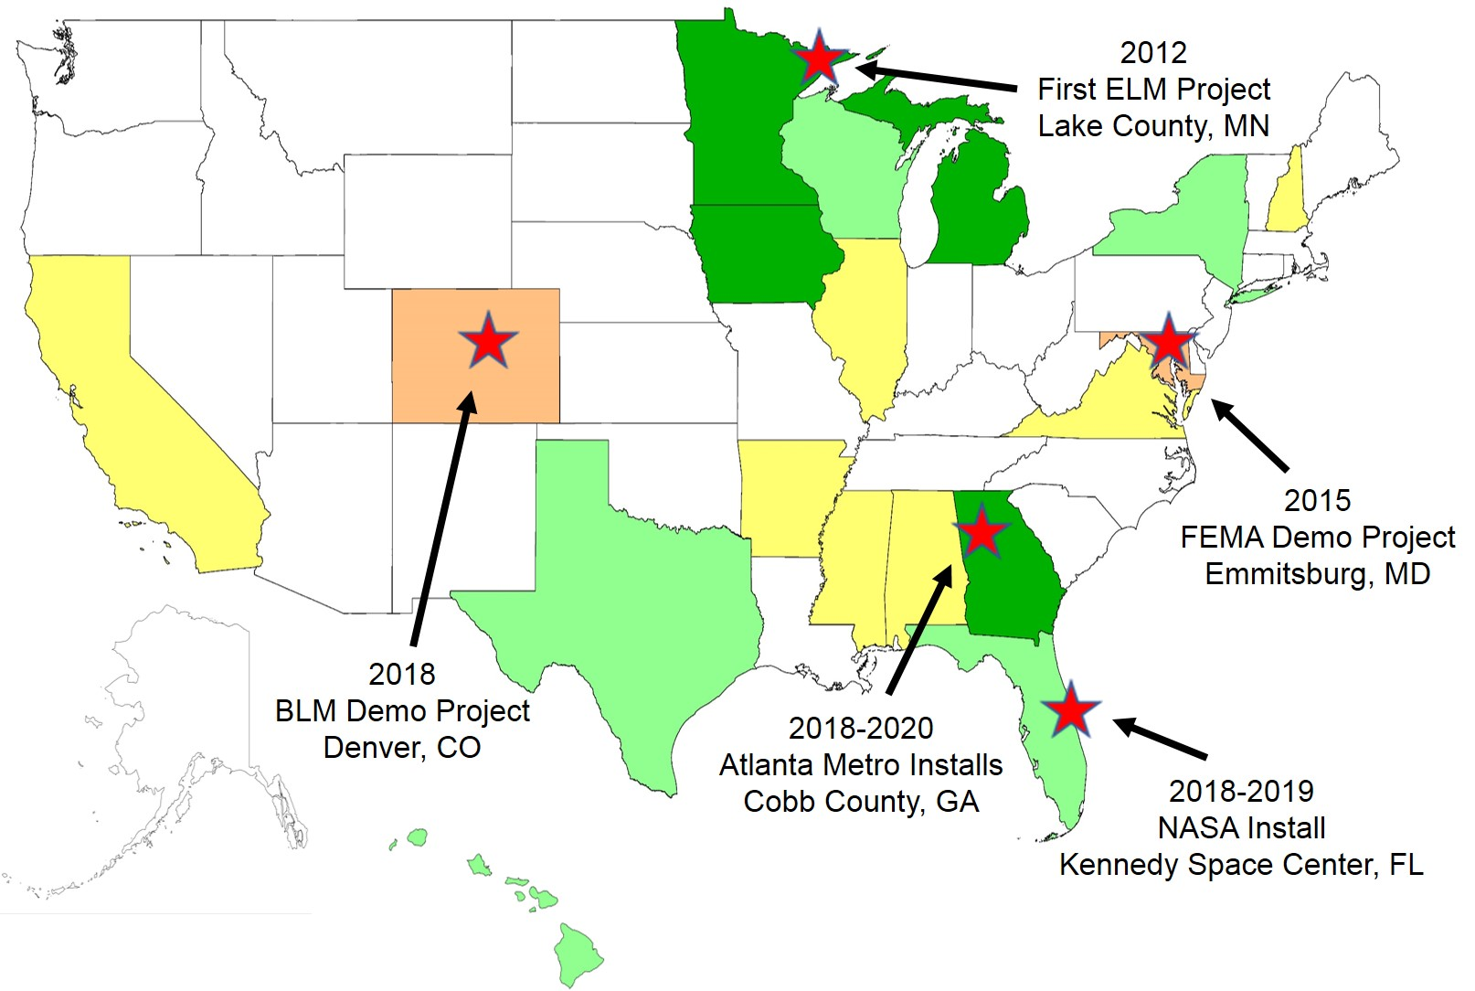
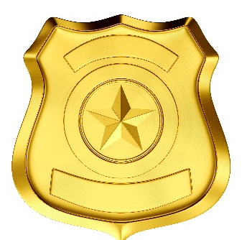




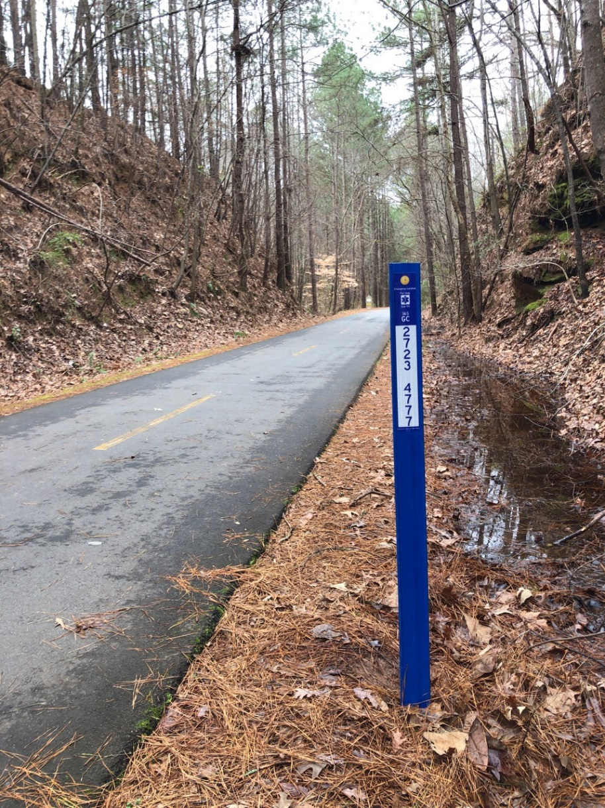
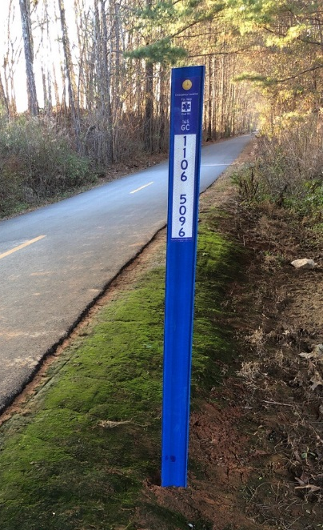
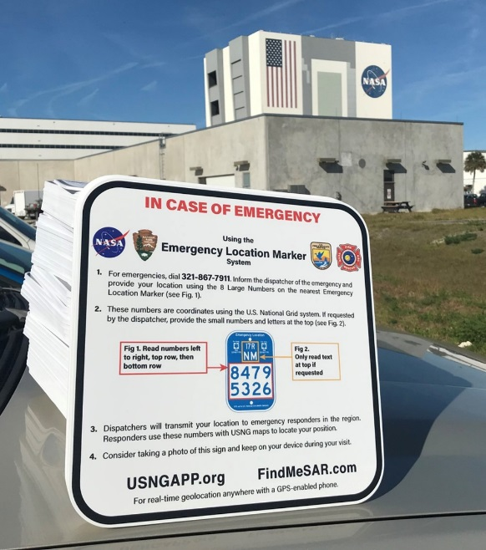
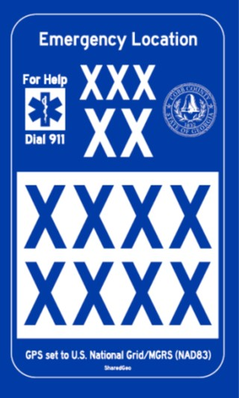
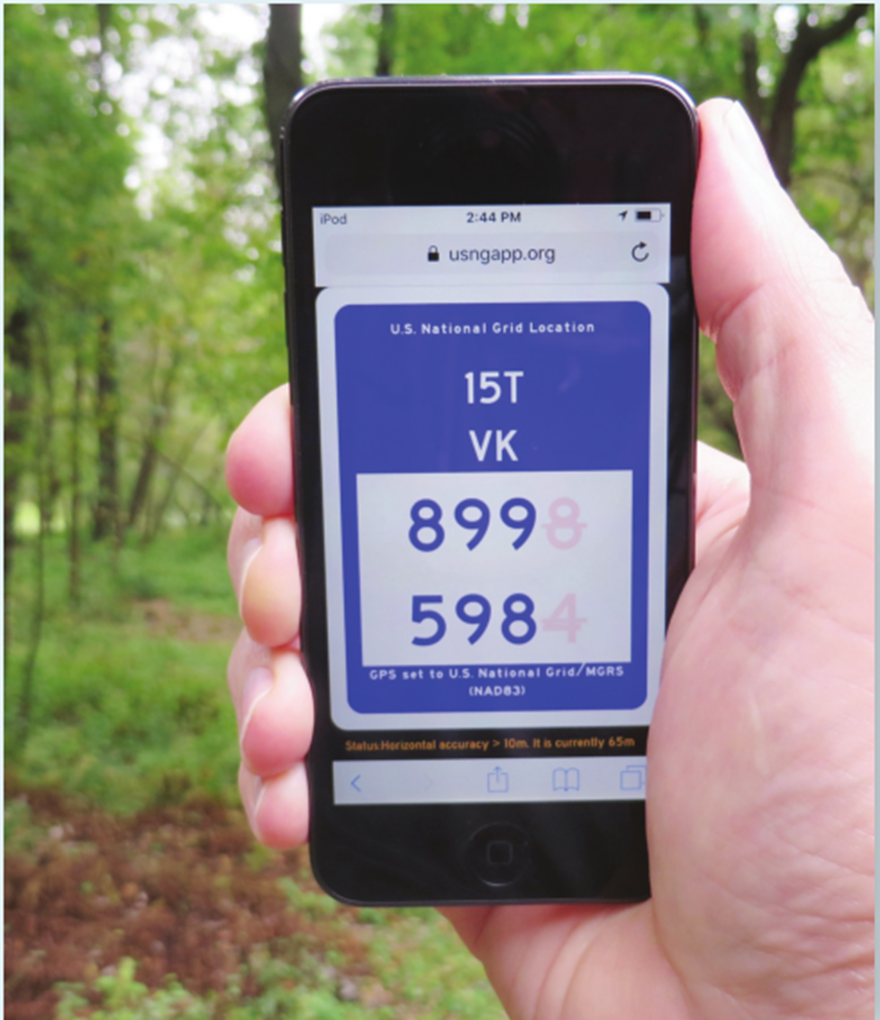
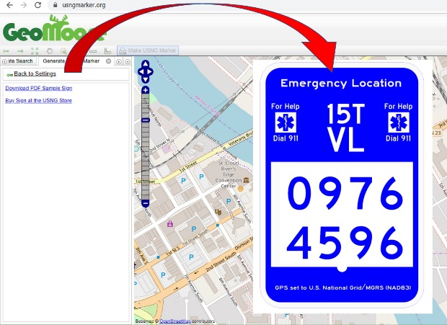
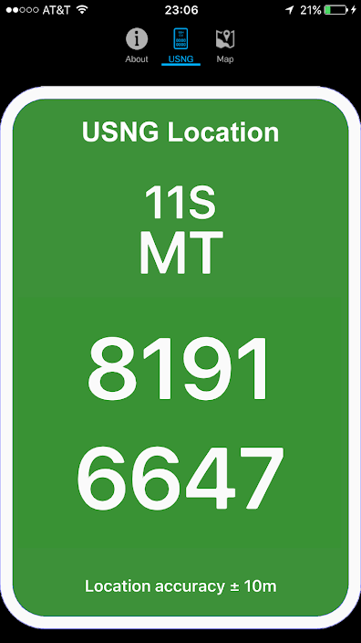
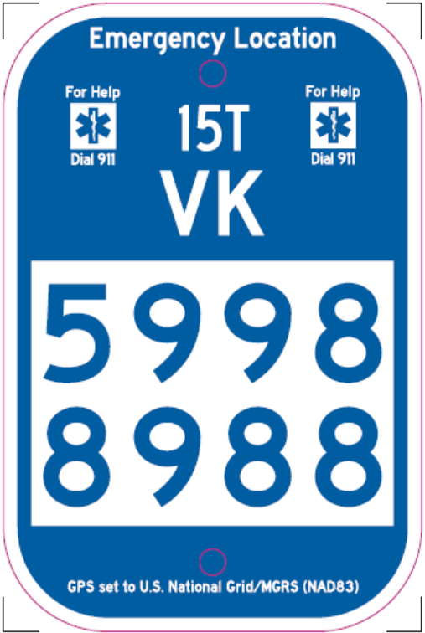
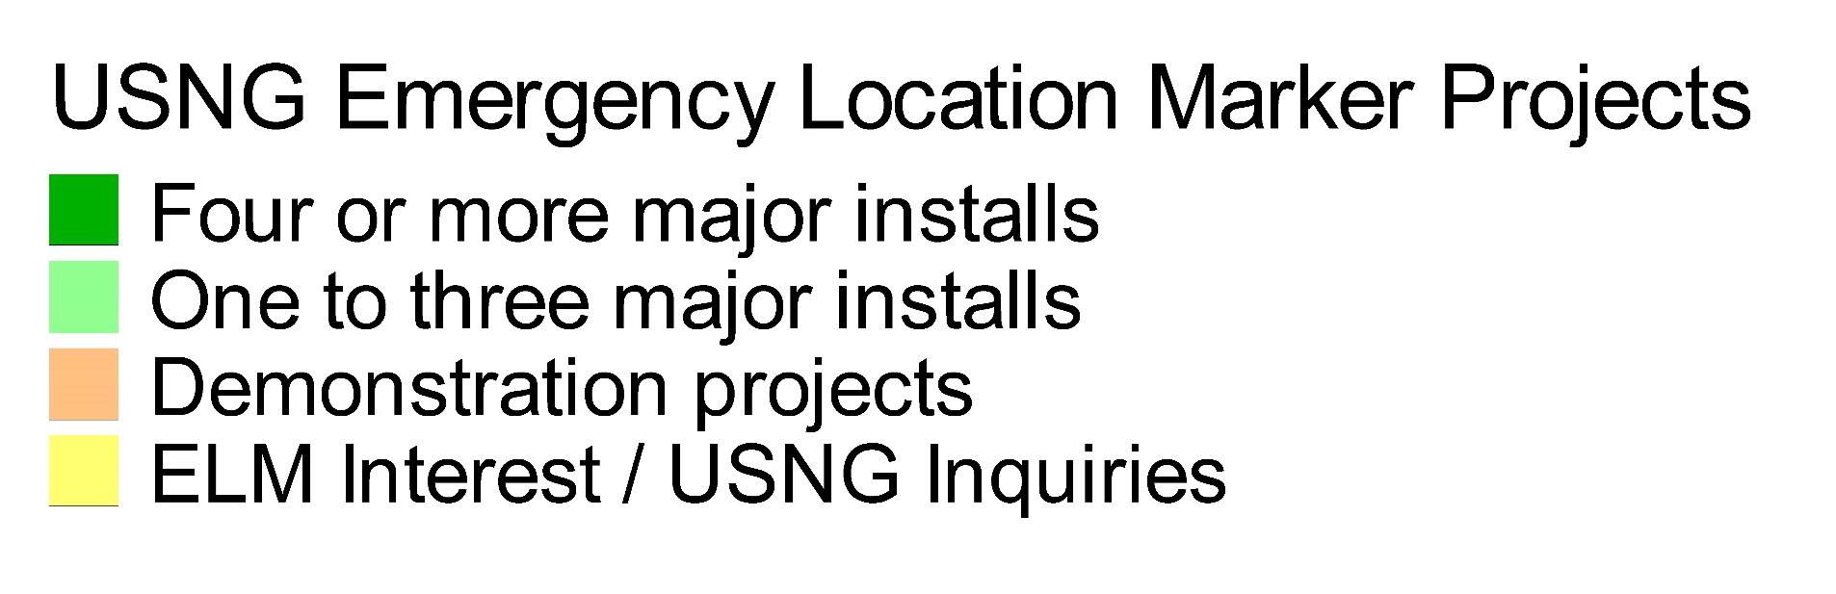

U.S. National Grid Speeds Emergency Response
Emergency Location Marker (ELM) Trail System
Steve Swazee and Nancy Read, SharedGeo
What
Why
One Minnesota ELM Trail System Becomes Many
How
More
Problem
34% of U.S. response calls go to a location without a street address – recreational trails are a leading category
Trails with location signs typically employ an approach which is unique to that park or trail system
Locally unique marking systems have NO VALUE to responders unless those locations are READILY AVAILABLE in dispatch and response systems
A Truly Collaborative Geospatial Project Which Saves Lives!
ELM Sizes and Styles
Originally released in three sizes (6x9, 9x12, 12x12) on .063 aluminum to conform to various trail marking regulations, additional versions and supplemental signs now include:
U.S. National Grid?
USNG is the U.S. portion of the Military Grid Reference System (MGRS) – a well-established worldwide metric coordinate standard used by NATO and the U.S. Armed Forces since the late 1940’s
In November 2011, the seven federal agencies which comprise the National Search and Rescue Committee, designated USNG as the standard for ALL ground based Search and Rescue (SAR) operations in the U.S.
In October 2015, FEMA designated USNG as its primary coordinate system and encouraged all partner organizations to do the same – USNG effectively became the nation’s “Emergency Response Language of Location”
But What About…
Latitude/Longitude?
  It’s base 60 math and nonstandard sized trapezoids are not conducive to responders understanding local location relationships
  13 digits are needed to get the same precision as an 8 digit USNG coordinate
  Format confusion has sent responses to the wrong location with deadly results (DD.MM.SS, DD.MM.mm, or DD.dddd)
Cell Phone Location Reporting?
  There are many instances where tower triangulation doesn’t work
  In spring 2018, numerous major news organizations reported on significant location inaccuracies inherent in cell phones and the substantial problems caused for 911 centers
Next Gen 9-1-1 (NG911) Systems?
  Nationwide adoption of NG911 has been slow and spotty, and likely many rural areas where recreational trails are located remain decades away from implementing
  USNG interoperability is a federal mandated data design standard of NG911 systems.
  USNG and associated ELMs are meant to augment and not replace other sanctioned emergency response location reporting approaches such street addresses
  1. Build your team
    Emergency Manager
    Responders (Law, Fire, EMS, SAR)
    911 Call Center (PSAP)
    County/city administration
    GIS support
    Federal, state, local and private land owners
    Trail user groups
  2. Plan system
    Average system density factors
        Rural = 1 ELM per mile
        Urban = 1 ELM per ¼ mile
    Average ELM delivered budgeting factors
        Standard ELM - $30/ea
        Info signs - $35/ea (see next panel)
        Carsonite vertical style - $55/ea (see next panel)
      Posts and hardware (use existing posts or need new?)
  3. Obtain funding
    Federal and state trail safety/improvement programs
    Corporate safety grants
    Trail user group fund raisers
    Local government funding
  4. Accurately record planned ELM locations
    Trail heads
    Road crossings
    Known accident locations
    Trail junctions
    Camping areas or rest stops
  5. Order ELMs, info signs and hardware
  6. Conduct responder and call center training
  7. Install signs and practice responses
  8. Publicize effort to ensure public knows how to use
Solution
Develop a standardized Emergency Location Marker (ELM) which can be used anywhere in the nation in a variety of scenarios
Align the marking system with established federal and state cartographic and signage standards
Ensure the format leverages GPS instead of requiring constant updating of Computer Aided Dispatch systems
Use a consistent approach which over time will become instantly recognizable by the public
Involve multiple stakeholders during development to ensure a “Best Practices” outcome
Vertical Style ELMs
ELM Information Signs
3x5” Custom ELM Stickers
ELM Apps
Responder “Star of Life” symbol avoids Red Cross proprietary issue
15T - UTM Grid Zone; 4x6 degrees
SharedGeo’s
usngapp.org
Make an ELM Online
usngmarker.org
Esri’s
MyUSNG
VK - USNG/MGRS 100 KM Square
ELM Quick Notes
“ELMs cut our trail response times by 90%”, Pete Walsh, Finland, MN Fire Chief
St. Paul, MN installed ELMs in Lilydale Regional Park after responders were unable to quickly locate a deadly accident in 2013
The ELM project in Cobb County, GA was cited as a reason the county won the state’s top IT Award in 2019
ELM YouTube videos: “USNG emergency location markers cobb”
8 USNG digits called into a 911 response center provide 33’ accuracy within an area of approximately 3,861 square miles.
Federal standard - Traffic Control Blue
As of September 2019
Design Development Partners
MGAC Emergency Preparedness Committee
Minnesota Department of Transportation
Minnesota Department of Natural Resources
Lake County Minnesota focus group (law, trail riders, etc.)
National focus group of responders and geospatial experts
www.sharedgeo.org
USNG Learning:
www.usngcenter.org
SharedGeo is a 501(c)3 nonprofit with a mission to help government, nonprofit, education and corporate entities use mapping technologies and share geographic data for the public good.

